Slide 1



Ensemble Deep Learning
Max Prilutsky - REU Correspondent
Dr. Jesse Adams and Dr. Maggie Lund
Nevada National Security Site
Dr. Mihhail Berezovski
Embry-Riddle Aeronautical University
Notes:
test

Slide 2
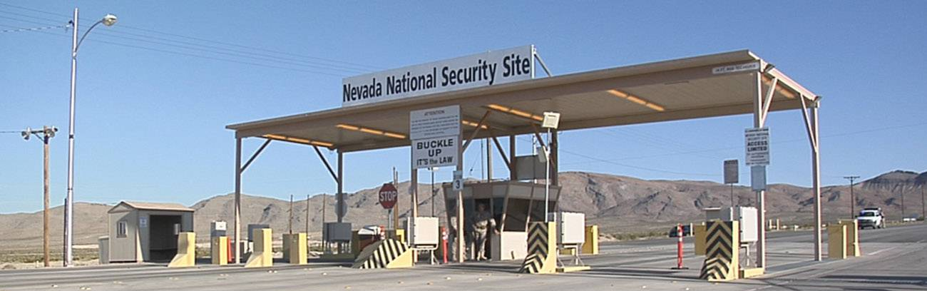
Nevada National Security Site(NNSS)
Mission: Ensure that the nation’s nuclear weapons stockpile remains safe, reliable, and secure
Small Scale, High Energy Experiments
High Level Computer Modeling

Slide 3
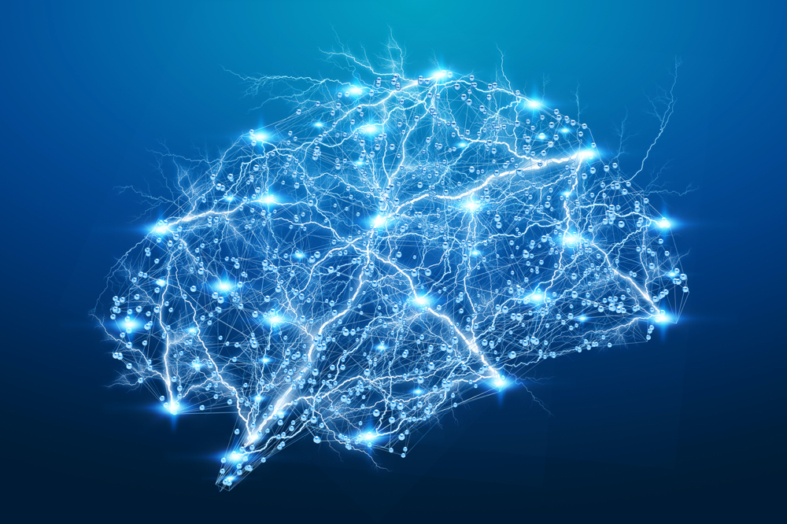
Our Project
Create an accurate neural network relating images of metal oxides to their spectra graphs
Find an error quantification for the resulting neural network

Slide 4


What Are Neural Networks?
Training
Testing

Slide 5
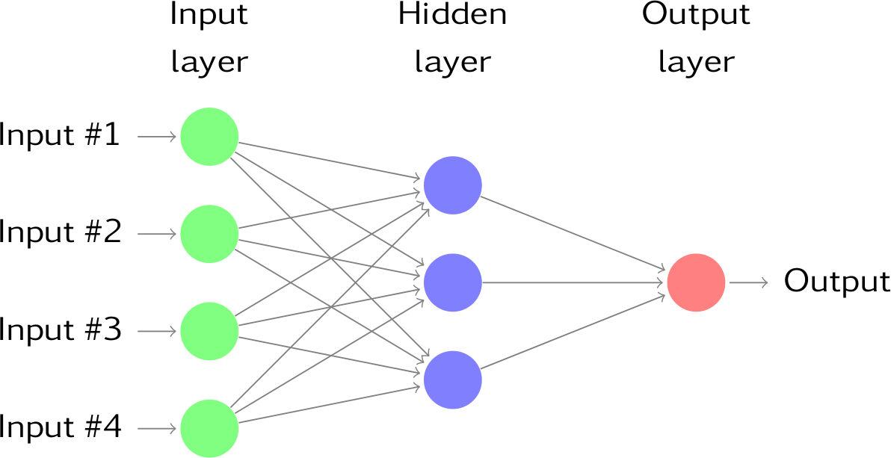
Sample Neural Network

Slide 6
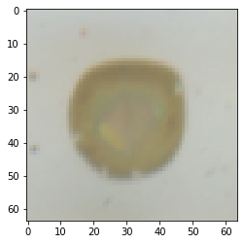
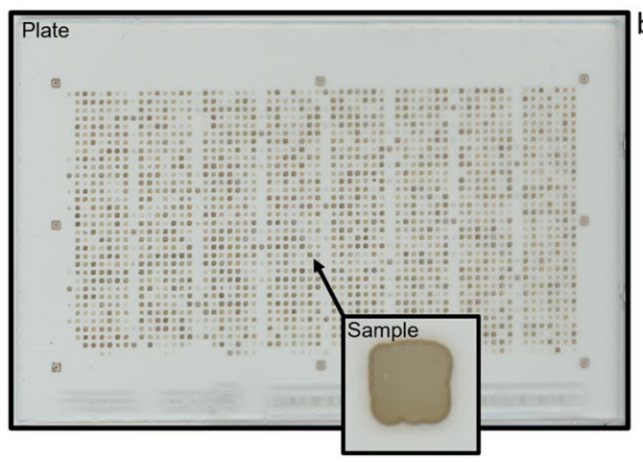
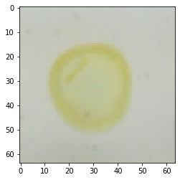
Dataset - Absorption Spectroscopy Data for Metal Oxides
Image Size: (64,64,3,180902)
Color values: RGB Normalized: 0–1 for every channel
Colored region in center representing printed material
“Coffee ring” on outer edge forms due to drying

Slide 7
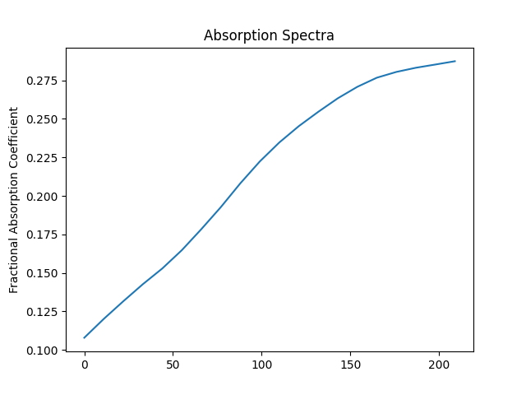
Data Interpretation
Image of Metal Oxide(Input)
Spectra Graph(Output)

Slide 8
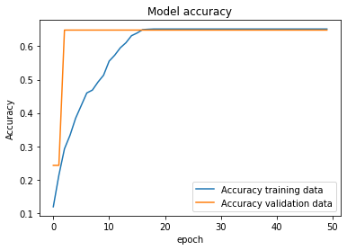
Initial Results
Layers Used
Convolutional
Dense
Max Pooling
Convolutional
Dense
Max Pooling
Convolutional
Convolutional
Max Pooling
Flatten
Dense
Dense
Dense

Slide 9
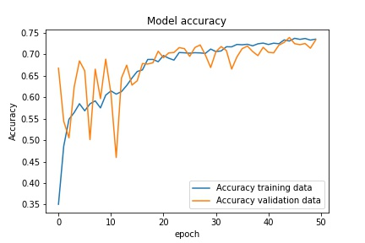
Initial Results Cont.
Layers Used
Convolutional
Dense
Max Pooling
Flatten
Dense
Dense
Dense

Slide 10
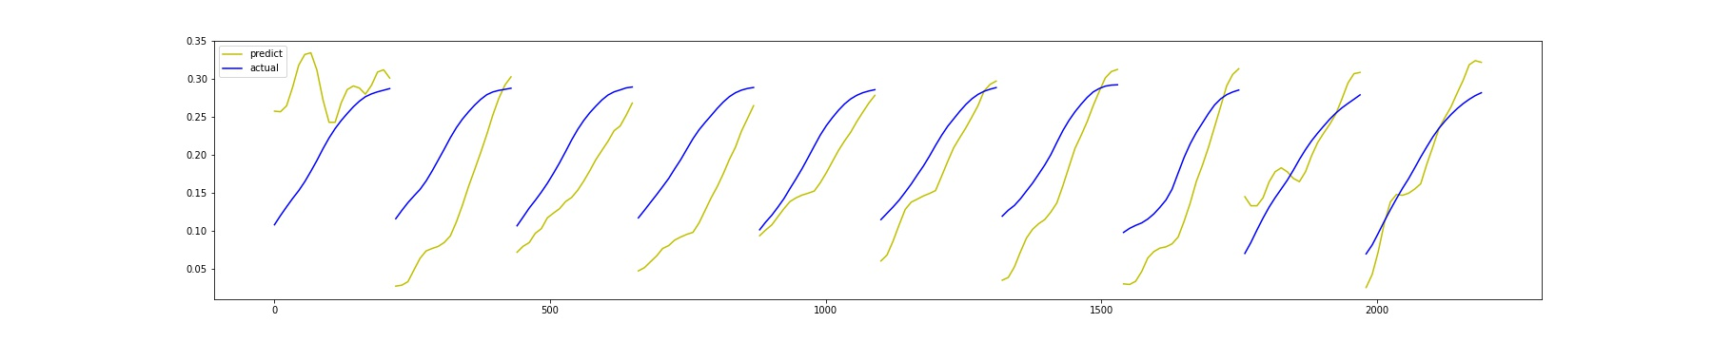
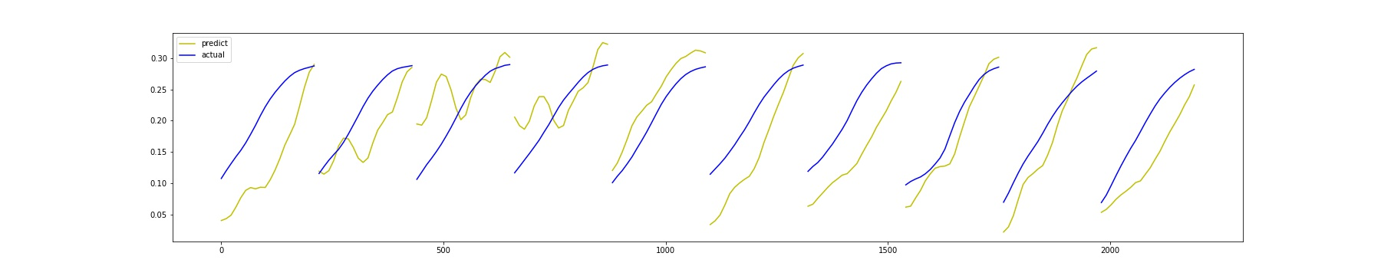
Error Measurement
Mean Squared
Mean Squared Logarithmic
Mean Absolute
Mean Absolute Percentage
Mean Squared
Mean Squared Logarithmic

Slide 11
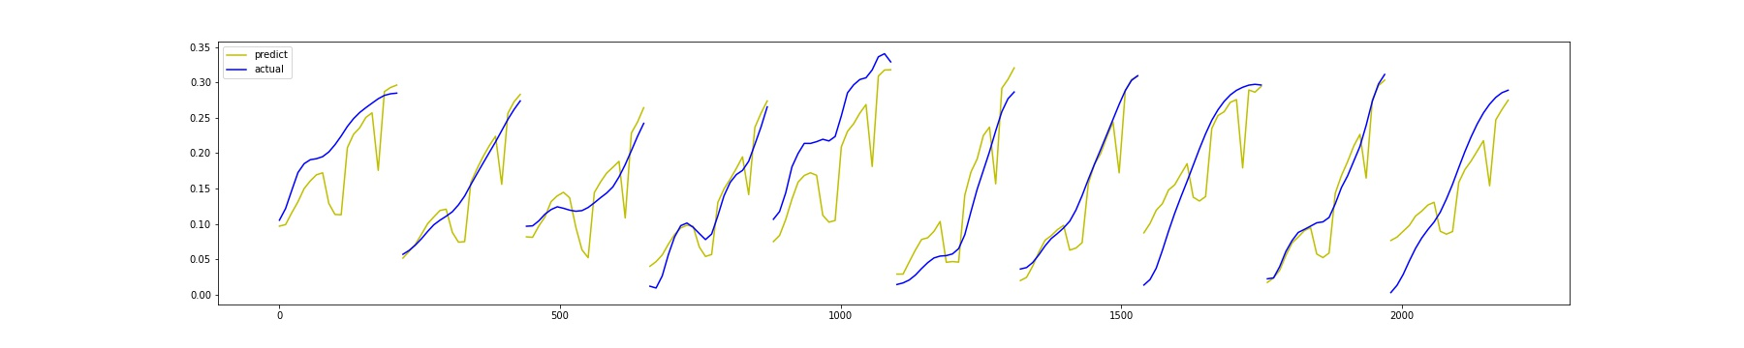
Ensemble Network
5 neural Networks
Trained on 4,000 different images
Averages the result of the 5 neural networks
Nearly uses all of Google Colab’s RAM

Slide 12
Next Steps
Implement a Neural Network to handle the outputs of the ensemble rather than just averaging them
Implement batch normalization in to the network
Continue to experiment with adding and subtracting layers
Create a custom loss function for our data

